Slide 1
Year 4 Times Tables Check
Parent Workshop : Wednesday 18th November 2020

Slide 2
Aims of this workshop
To achieve a stronger understanding of what the Multiplication Tables Check (MTC) is and what the expectations are
To understand how , when and why the Multiplication Tables Check (MTC) will be administered
To achieve a stronger understanding of how times tables is taught in Year 4
To be provide you with a range of strategies and websites you can use with your child at home

Slide 3
Primary-school children were expected to know all their times tables up to 12x12 by the time they reached Year 6 and they were not formally tested on them other than through multiplication questions in the Year 6 Maths SATS examinations.
What were the times tables expectations prior to the introduction of the Multiplication Tables Check (MTC)?

Slide 4
Under the current National Curriculum, children are supposed to know their times tables by the end of Year 4, and in preparation for the MTC test.
What are the times tables expectations now that the Multiplication Tables Check (MTC) has been introduced?

Slide 5
The Multiplication Tables Check (MTC) was officially announced by the Department for Education (DfE) in September 2017.
What is the Times Tables Check/ The Multiplication Tables Check (MTC)?

Slide 6
Since the 2019/20 academic year, all state-funded maintained schools and academies (including free schools) in England will be required to administer the MTC to Year 4 pupils.
Do all pupils in the UK need to take the MTC?

Slide 7
- Children with special educational needs will be provided for when taking the MTC e.g., extra time, an adult to read out the question, an enlarged screen, etc.
What if my child has a statement of special educational needs?

Slide 8
- All Year 4 children will have their multiplication skills formally tested in the Summer Term of this academic year 2020-2021. - Schools will have a 3 week window to administer the MTC. - Teachers will have the flexibility to administer the check to individual pupils, small groups or a whole class at the same time.
When will the Multiplication Tables Check be administered?

Slide 9
• School-level results and individual pupil results will be made available to schools. This will allow schools to provide additional support to pupils who require it. • National results will be reported by the Department for Education (DfE) to track standards over time. • National and local authority results will be reported by the DfE to allow schools to benchmark the performance of their pupils.
How will the MTC data be used now that the check is compulsory?

Slide 10
Children will be tested using an on-screen check (on a computer or a tablet), where they will have to answer multiplication questions against the clock. Calculators and wall displays that could provide children with answers will be removed from the room the MTC is taking place in. The test will last no longer than 5 minutes and is similar to other tests already used by primary school. It will be automatically scored, and results will be available to schools once the assessment window closes at the end of the week assessment period.
How will the Multiplication Tables Check be administered?

Slide 11
Children will have 6 seconds to answer each question in a series of 25 questions. This allows pupils the time required to demonstrate their recall of multiplication tables, whilst limiting pupils’ ability to work out answers to the questions. Each question will be worth one mark and be presented to the child in this format: _ x _ = ____
How will the Multiplication Tables Check be administered? (continued...)

Slide 12
The Year 4 programme of study for mathematics (National Curriculum) also states, ‘pupils should be taught to recall multiplication and division facts for multiplication tables up to 12 × 12’. However the MTC only assesses the instant recall of multiplication facts. Multiplication and division in a wider context will continue to be assessed through the KS1 and KS2 mathematics assessments.
How will the Multiplication Tables Check be administered? (continued...)

Slide 13
How will the Multiplication Tables Check be administered? (continued...)
Each pupil will be randomly assigned a set of questions.
There will be repeated questions across different checks each year, but no more than 30% of questions will be repeated in any two checks.
Children will only face multiplication statements in the check (not related division facts).
Pupils will not see their individual results when they complete the check.
There will always be questions from the 3, 4, 5, 6, 7, 8, 9, 11 and 12 multiplication tables in each check.
There will be no questions from the 1 times table (i.e 1 x 8 or 8 x 1).
The 6, 7, 8, 9 and 12 times tables are more likely to be asked.
There will only be a maximum of 7 questions from the 2, 5 and 10 times tables.
Reversal of questions will not feature in the same check.

Slide 14
Questions more likely to appear
The following 11 multiplication questions are more likely to be asked:
6 x 6, 6 x 7, 6 x 8, 6 x 9, 6 x 12
7 x 8, 7 x 9, 7 x 12
8 x 9, 8 x 12
12 x 12

Slide 15
Once the child has inputted their answer on the computer / device they are using, there will be a three-second pause before the next question appears. Children will be given the opportunity to practise answering questions in this format before the official check begins.
How will the Multiplication Tables Check be administered? (continued...)

Slide 16
At present the DfE have not issued an official "pass mark“. Watch the video for additional information https://youtu.be/GhAJMJUsAac
What is the pass mark for the test?

Slide 17
How is the school preparing pupils for the MTC?
How is multiplication taught in Year 4?
Teaching times tables facts first:
Counting and looking for patterns
Repeated addition
Multiplication is commutative
Multiplication is the inverse of division
Number families
Use of different representations
Concrete manipulatives such as counters or multilink cubes
Pictorial representations such as arrays

Slide 18
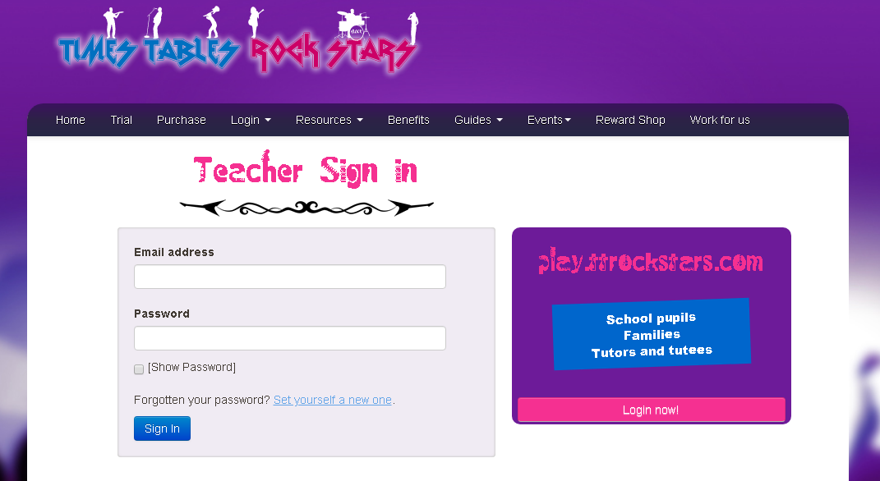
TIMES TABLES ROCKSTARS https://ttrockstars.com/login -At home and in-school learning platform -Get your child to practise daily for 15 minutes
What else is the school doing to prepare pupils for the MTC?

Slide 19
BASELINE TEST https://www.timestables.co.uk/multiplication-tables-check/ -In school test - Your child can also use this online tool to practise at home -Administered at the beginning of the year to assess each childs’ starting point and gaps in learning
What else is the school doing to prepare pupils for the MTC?

Slide 20
Example multiplication table check
You can use this free multiplication table check which will give you an idea of the speed at which children will be asked questions:
https://mathsframe.co.uk/en/resources/resource/477/Multiplication-Tables-Check

Slide 21
TIMES TABLES BOOKLETS -In-school learning tool -Get your child to practise weekly
What else is the school doing to prepare pupils for Multiplication Tables Check?

Slide 22
What can you do at home to support your child?
Firstly, a positive attitude goes a long way – so as much encouragement and support as possible (but we don’t need to tell you that)!
Some further tips:
Make times tables fun;
Climb stairs counting in multiples
Play verbal times tables games
Listen to and learn times tables songs
Take it in turns to say different times tables in funny voices (i.e. say 2 x 3 = 6 in a lion’s voice)
Play online maths games
Talk directly to your child’s class teacher if you have any worries (try not to worry your child);
Encourage your child to talk to you, their teacher, or another adult they trust, if they express persisting anxieties about the check. Remember that a small amount of anxiety is normal and not harmful.

Slide 23
Times Tables Rock Stars https://ttrockstars.com/login https://www.timestables.co.uk/multiplication-tables-check/
What can you do at home to support your child?

Slide 24
National Curriculum https://assets.publishing.service.gov.uk/government/uploads/system/uploads/attachment_data/file/335158/primary_national_curriculum_-_mathematics_220714.pdf Department of Education (DfE ) https://www.gov.uk/guidance/multiplication-tables-check-development-process
Useful Websites

Slide 25
Useful Websites
Maths Games http://www.maths-games.org/times-tables-games.html
Cool Maths https://www.coolmathgames.com/
Ixl https://uk.ixl.com/
Times tables Rock starS https://ttrockstars.com/
Topmarks https://www.topmarks.co.uk/
DfE Video - https://youtu.be/GhAJMJUsAac

Slide 26
Questions?

